Slide 1
Flash type ADC and Monolithic ADC

Slide 2
Flash Type ADC
It is Direct Type ADC.
It is also named as Parallel Comparator ADC.
It is the simplest,
fastest and
most expensive technique.
It is formed of a series of comparators.
Each one comparing the input signal to a unique reference voltage.
The comparator outputs connect to the inputs of a priority encoder circuit, which then produces a binary output.

Slide 3
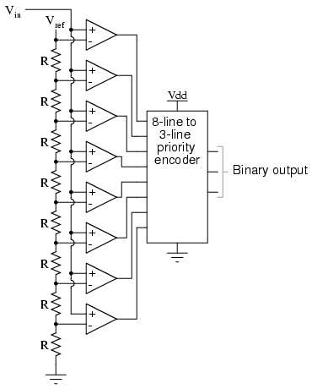
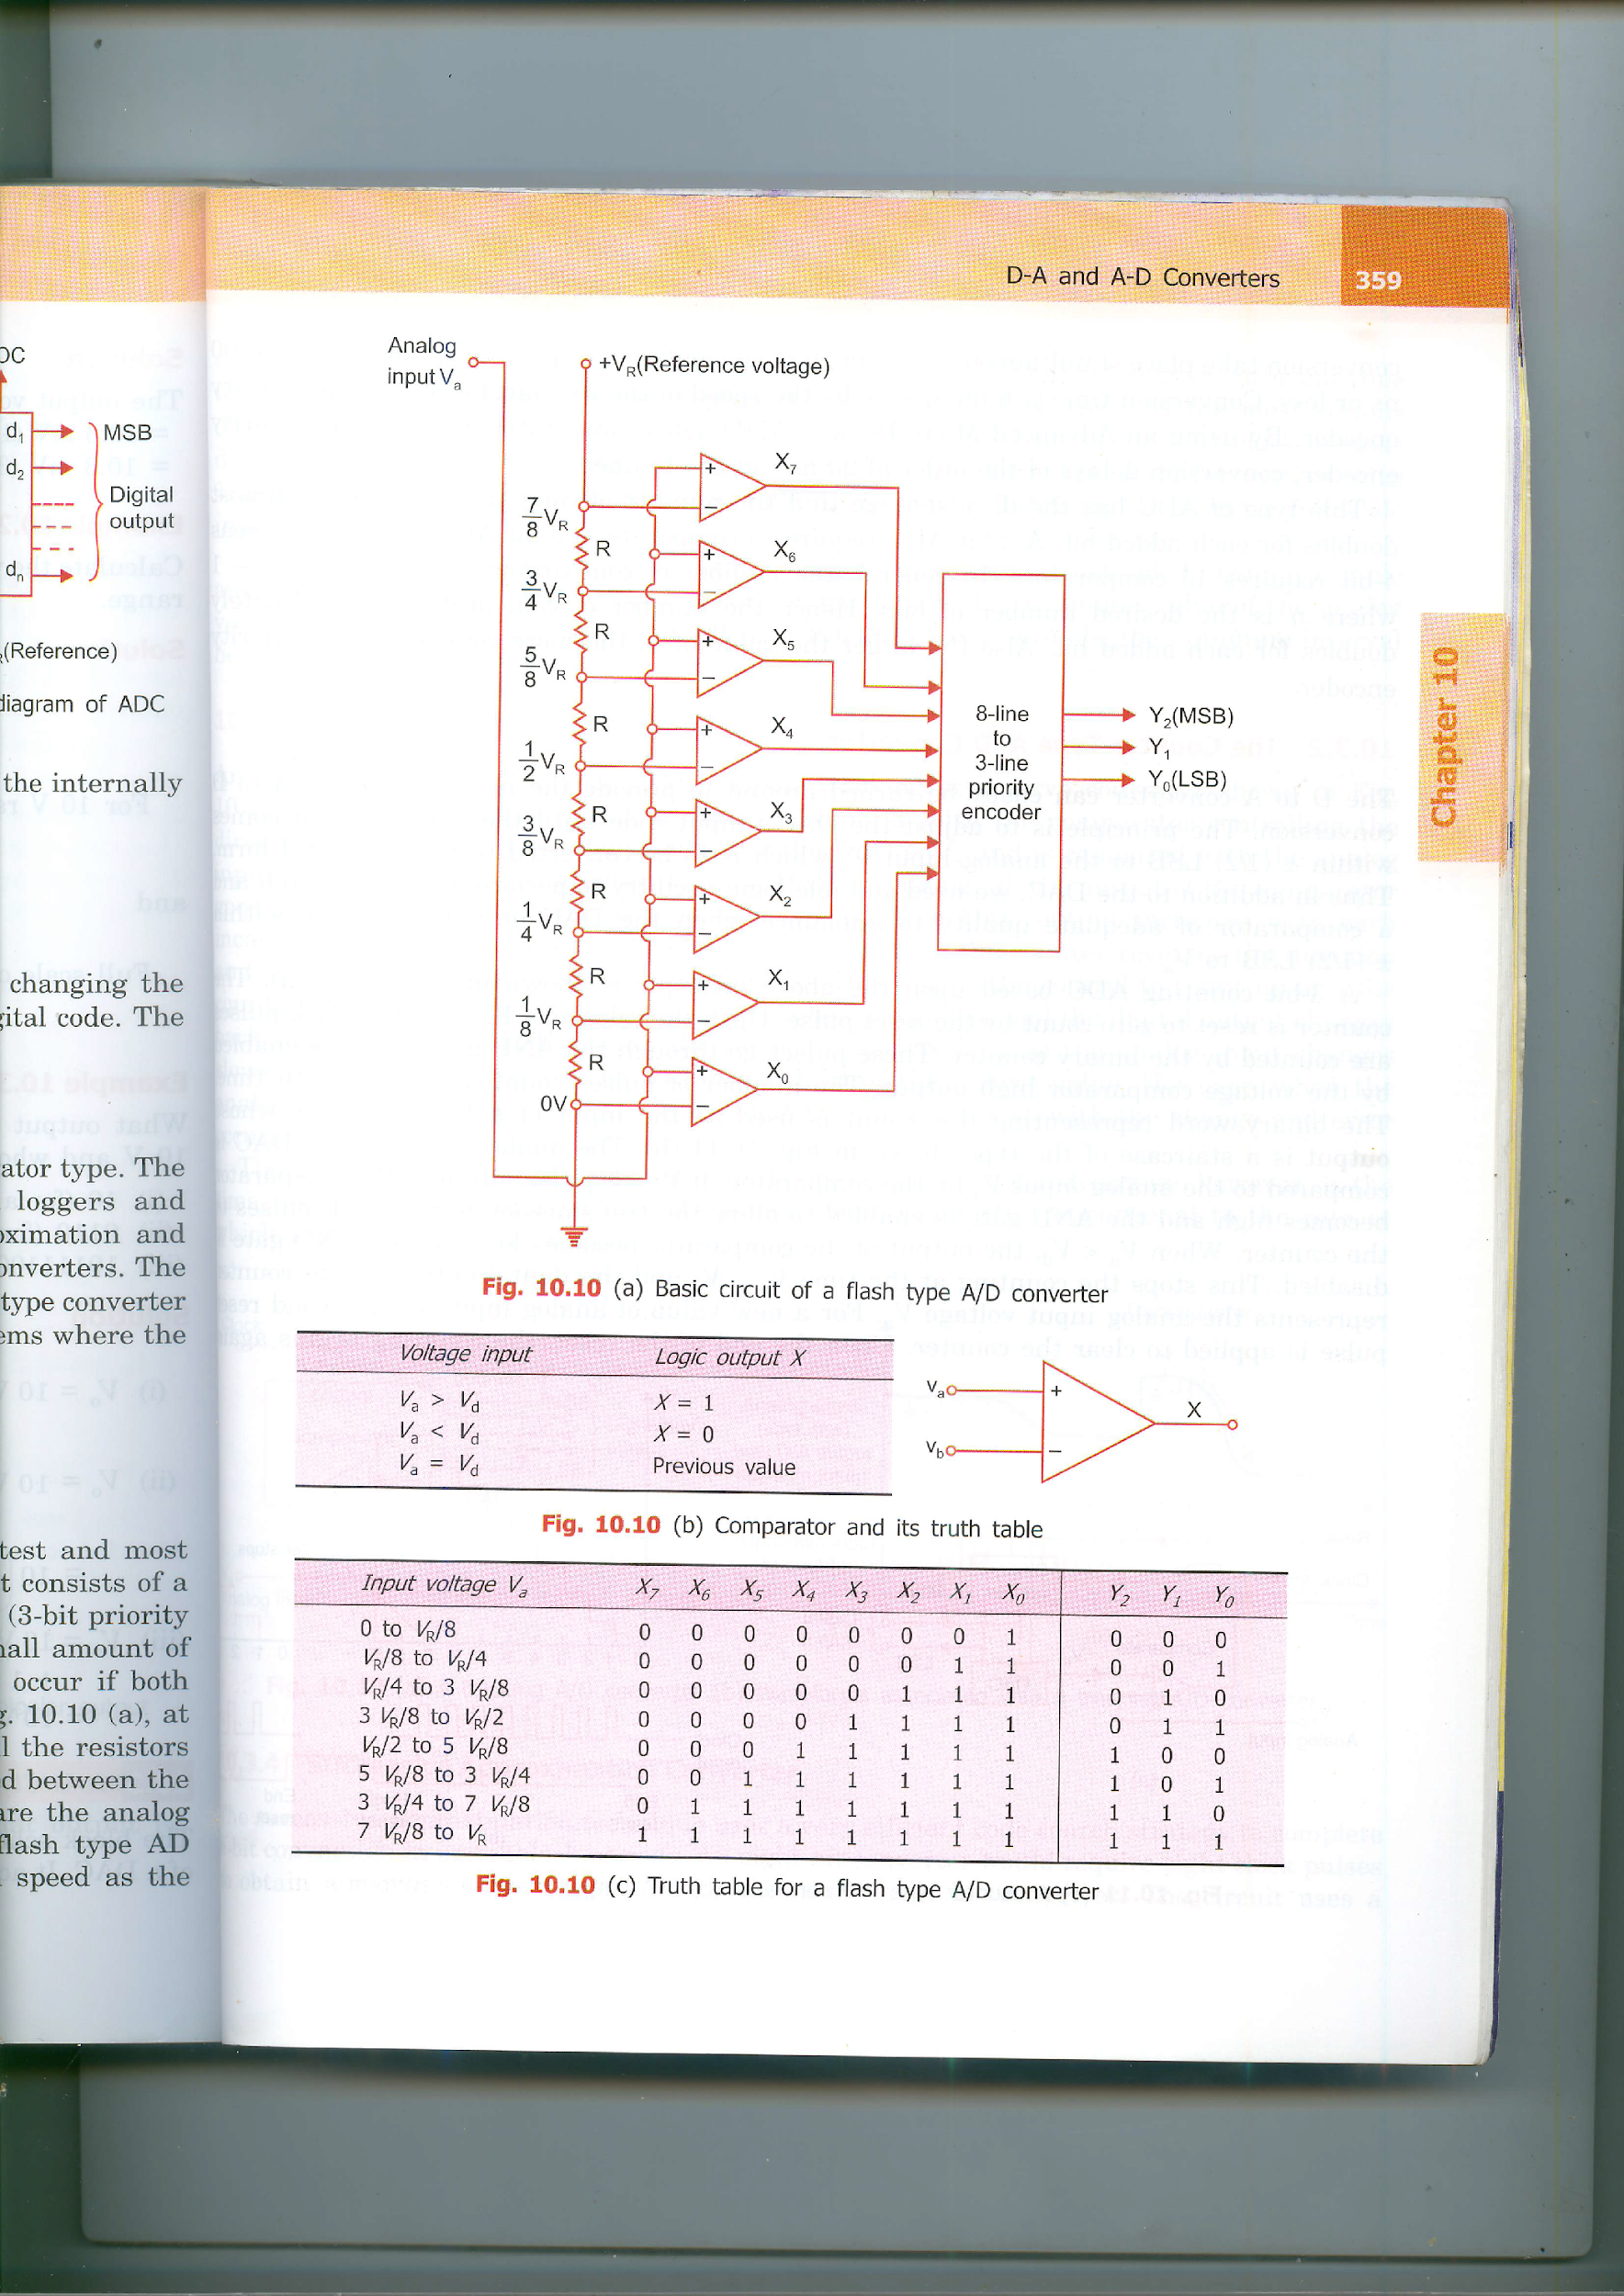
Basic circuit of Flash Type ADC

Slide 4
Basic circuit of Flash Type ADC
The circuit consists of a resistive divider network, 8 op-amp comparators and a 8-line to 3-line encoder (3-bit priority encoder).
At each node of the resistive divider, a comparison voltage is available.
Since all the resistors are of equal value, the voltage levels available at the nodes are equally divided between the reference voltage V_{R} and the ground.
The purpose of the circuit is to compare the analog input voltage V_{a}, with each of the node voltages.

Slide 5
Flash Type ADC – Comparator and its truth table
A small amount of hysteresis is built into the comparator to resolve any problems that might occur if both inputs were of equal voltage as in the truth table.

Slide 6
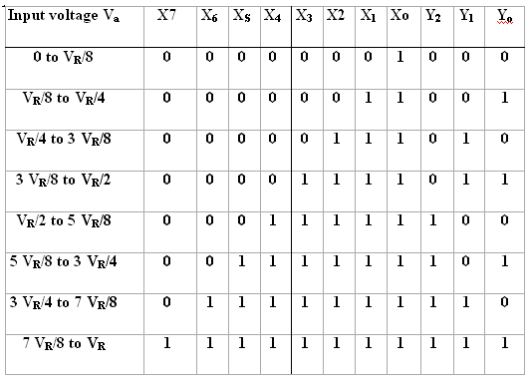
Flash Type ADC Truth Table

Slide 7
Flash Type ADC cont…
Advantage
It has high speed as the conversion take place simultaneously rather than sequentially. Typical conversion time is 100 ns or less.
Conversion time is limited only by the speed of the comparator and of the priority encoder.
Disadvantage
The number of comparators required almost doubles for each added bit.
A 2-bit ADC requires 3 comparators, 3-bit ADC needs 7, whereas 4-bit requires 15 comparators.
In general, the number of comparators required is 2^{n} -1, where n is the desired number of bits.
The larger the value of n, the more complex is the priority encoder.

Slide 8
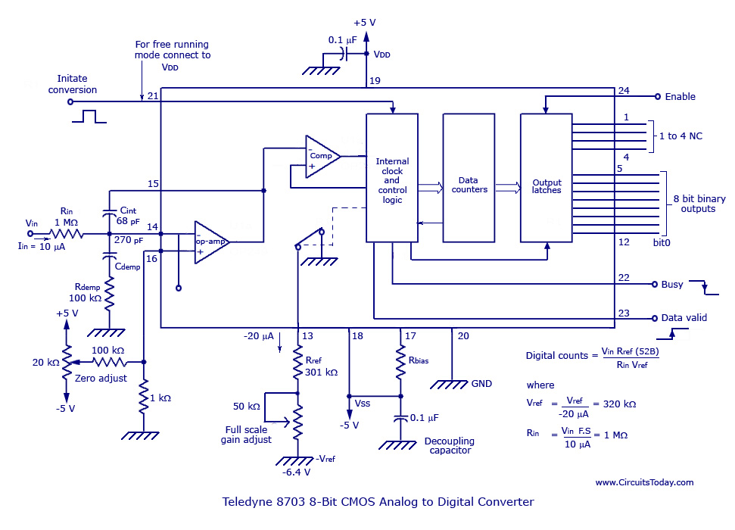
Monolithic ADC
The figure illustrates an 8-bit monolithic (Teledyne 8703) CMOS ADC with three-state output.
It is a 24-pin DIP package.
The converter is made compatible with a microprocessor.
It also exhibits high stability over a full temperature range.
It has all the needed active elements, and has latched parallel binary outputs with strobed or free-running conversion.
It has an infinite input range since any positive voltage can be applied through a scaling register R_{in}.
(Courtesy: Teledyne Semi-conductor)

Slide 9
Monolithic ADC
As in the case of monolithics, there are many hybrid A/D converters, such as the successive-approximation A/D with input buffer amplifier, the low-power CMOS A/D, the fast A/D with sample-and-hold, and the ultrafast A/D with input buffer amplifier.
Datel Intersil’s hybrid ADC-815MC is a very high speed 8-bit successive-approximation A/D converter.
It is capable of 8-bit resolution in only 600 nano seconds.
It has a six analog-input voltage range with parallel or serial outputs and requires no calibration.
Datel’s ADC-MC8B is an 8-bit monolithic multi-function A/D-D/A converter that operates on a single +5-V supply.
It is a complete D/A converter that can be configured as an A/D converter by using an external comparator and a quad two-input Schmitt trigger NAND gate.

Slide 10
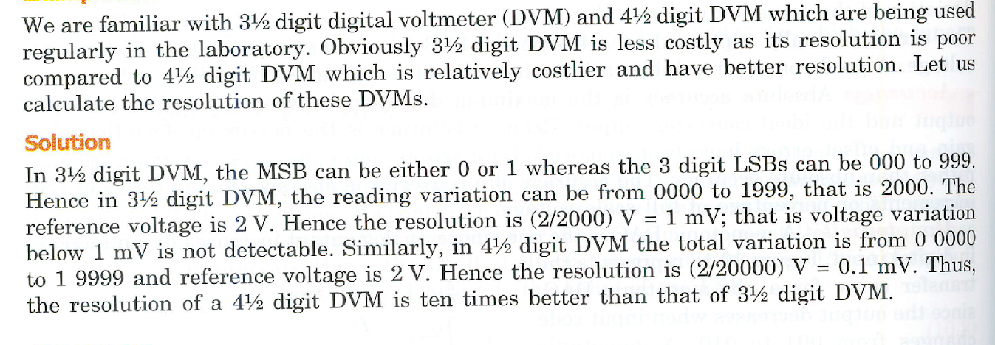
Problem in Resolution

